Slide 1
Single-neuron representations of odours in the human brain
Kehl et al. 2024
Nature Vol. 634

Slide 2
Abstract
Electrophysiology in awake humans.
Epilepsy patients
N = 17

Slide 3
Abstract
Identified odor-modulated neurons in
Piriform cortex
Amygdala
Entorhinal cortex
Hippocampus

Slide 4
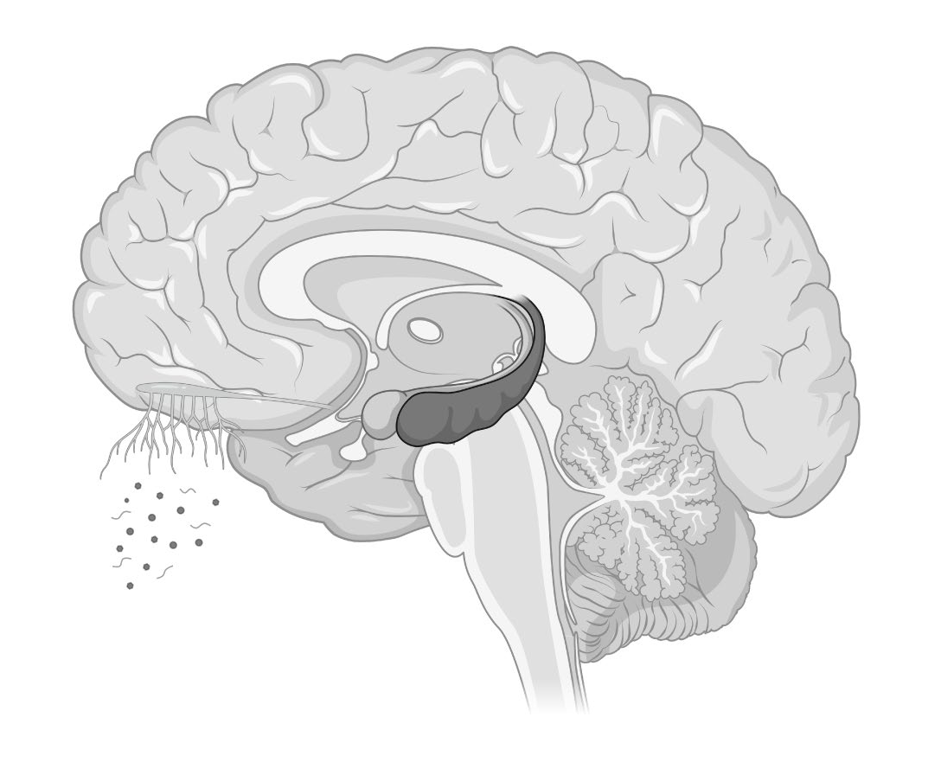
Olfaction
Smell
Taste
Navigation

Slide 5
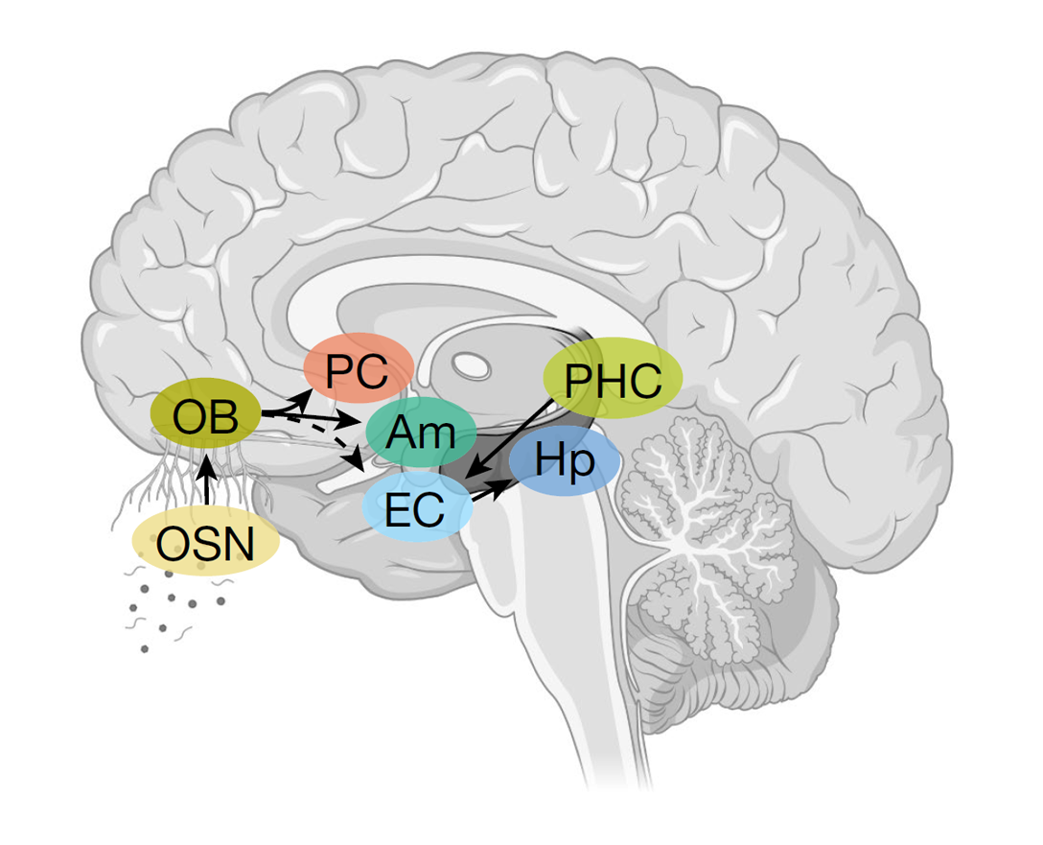
Olfaction
Odor Sensory Neurons (OSN)
Olfactory Bulb (OB)
Piriform Cortex (PC)
Amygdala (Am)
Entorhinal Cortex (EC)
Hippocampus (Hp)
Parahippocampal Cortex (PHC)

Slide 6
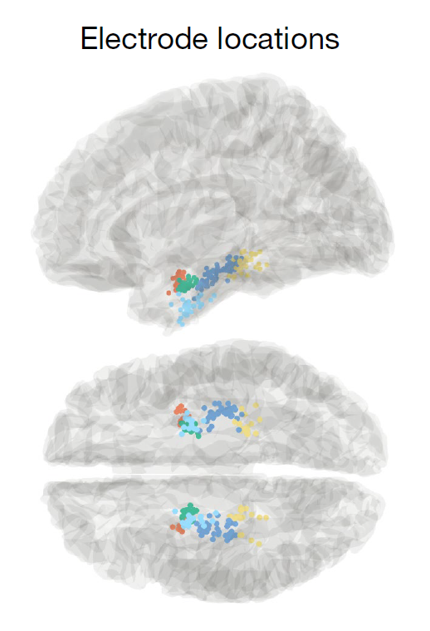
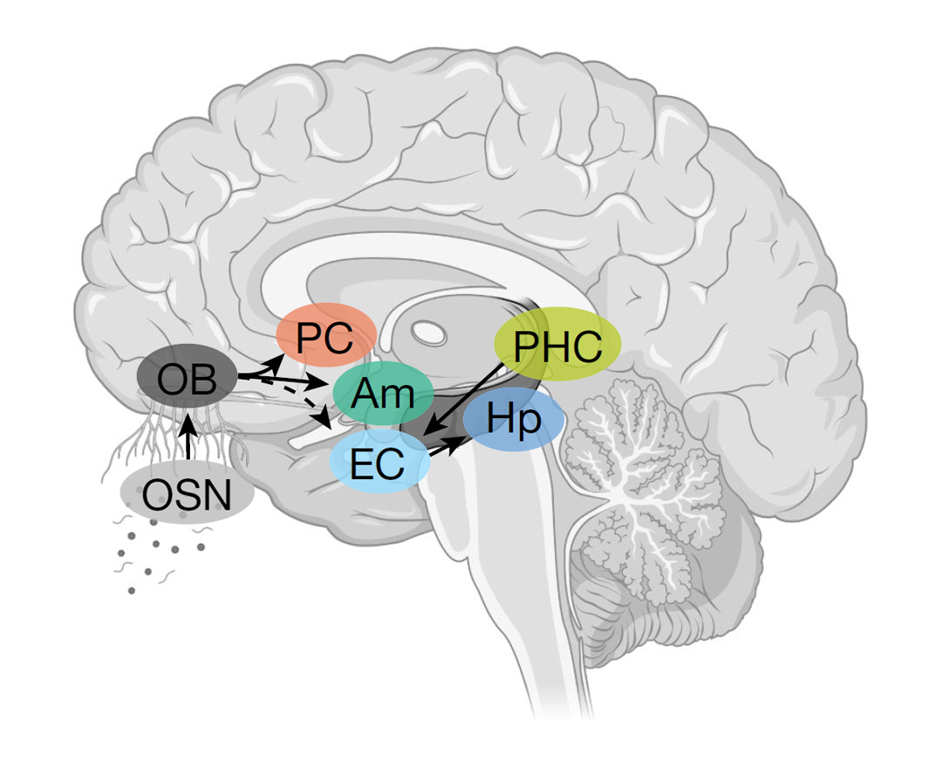

Slide 7
Multimodal odor-modulated cells
Identified neurons that respond to semantically-coherent odor/image inputs.

Slide 8
Task
Results

